Slide 1

Analysis of Dynamic Models: Phase Portraits
MTH 564 – Mathematical Modeling

Slide 2

Overview
When examining eigenvalues for stability analysis, we used the idea of local linearity. That is, we used the Jacobian to tell us about the behavior system near the equilibrium.
We now apply this same idea to finding a graphical description of the behavior of a dynamical system near an equilibrium.
This information along with a plot of the vector field can be used to create a graphical description of the dynamics of the system over the entire state space. Such a plot is called a phase portrait.

Slide 3
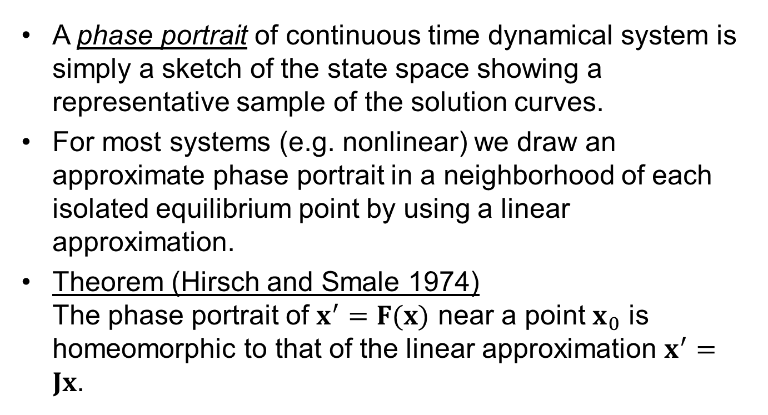
Phase Portrait
A phase portrait of continuous time dynamical system is simply a sketch of the state space showing a representative sample of the solution curves.
For most systems (e.g. nonlinear) we draw an approximate phase portrait in a neighborhood of each isolated equilibrium point by using a linear approximation.
Theorem (Hirsch and Smale 1974) The phase portrait of $x^{′}=F(x)$ near a point $x_{0}$ is homeomorphic to that of the linear approximation $x^{′}=Jx$.

Slide 4
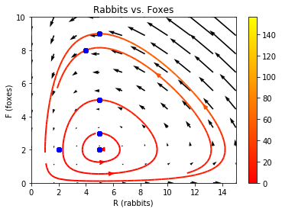
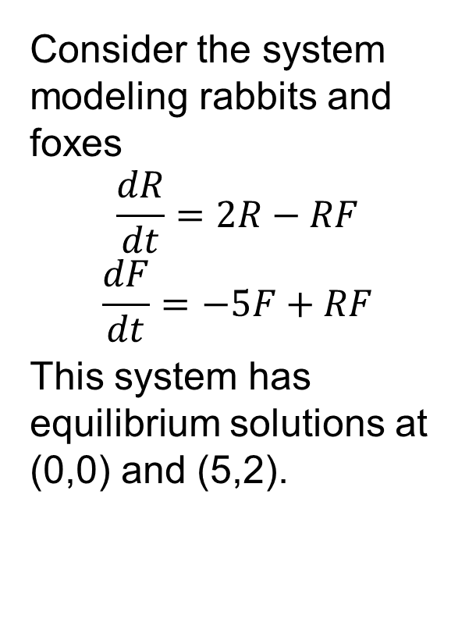
Phase Portrait: Example
Consider the system modeling rabbits and foxes
$$\frac{dR}{dt}=2R−RF$$
$$\frac{dF}{dt}=−5F+RF$$
This system has equilibrium solutions at (0,0) and (5,2).

Slide 5
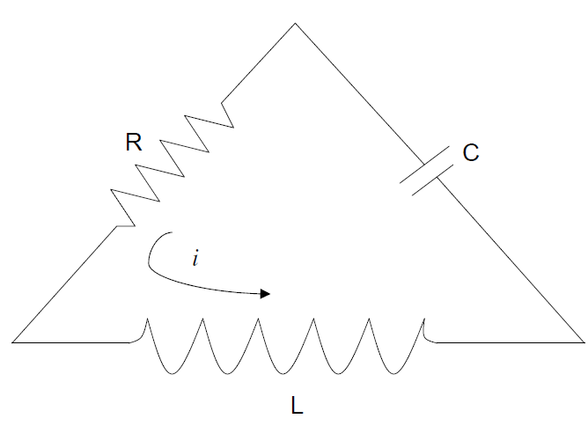
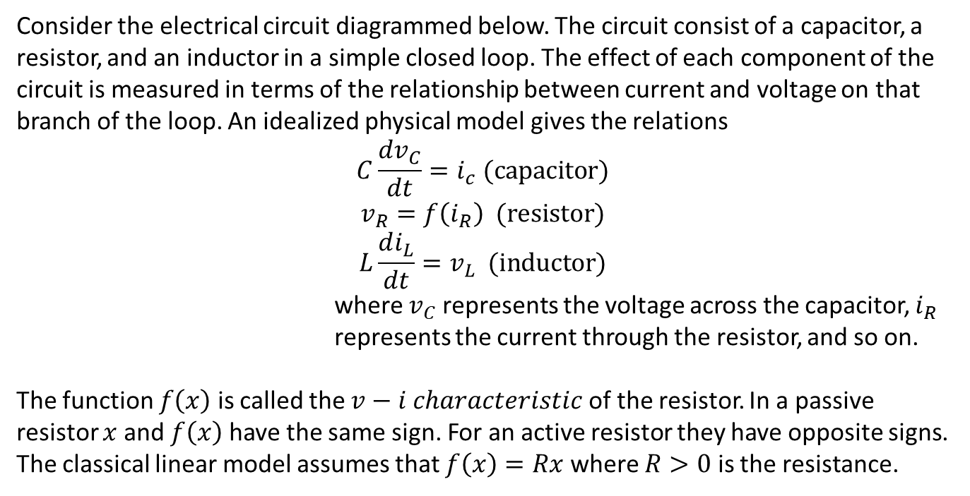
Circuits
Consider the electrical circuit diagrammed below. The circuit consist of a capacitor, a resistor, and an inductor in a simple closed loop. The effect of each component of the circuit is measured in terms of the relationship between current and voltage on that branch of the loop. An idealized physical model gives the relations
$$C\frac{dv_{C}}{dt}=i_{c} (capacitor)$$
$$v_{R}=f\left(i_{R}\right) (resistor)$$
$$L\frac{di_{L}}{dt}=v_{L} (inductor)$$
where $v_{C}$ represents the voltage across the capacitor, $i_{R}$ represents the current through the resistor, and so on.
The function $f\left(x\right)$ is called the $v−i characteristic$ of the resistor. In a passive resistor $x$ and $f\left(x\right)$ have the same sign. For an active resistor they have opposite signs. The classical linear model assumes that $f\left(x\right)=Rx$ where $R>0$ is the resistance.

Slide 6
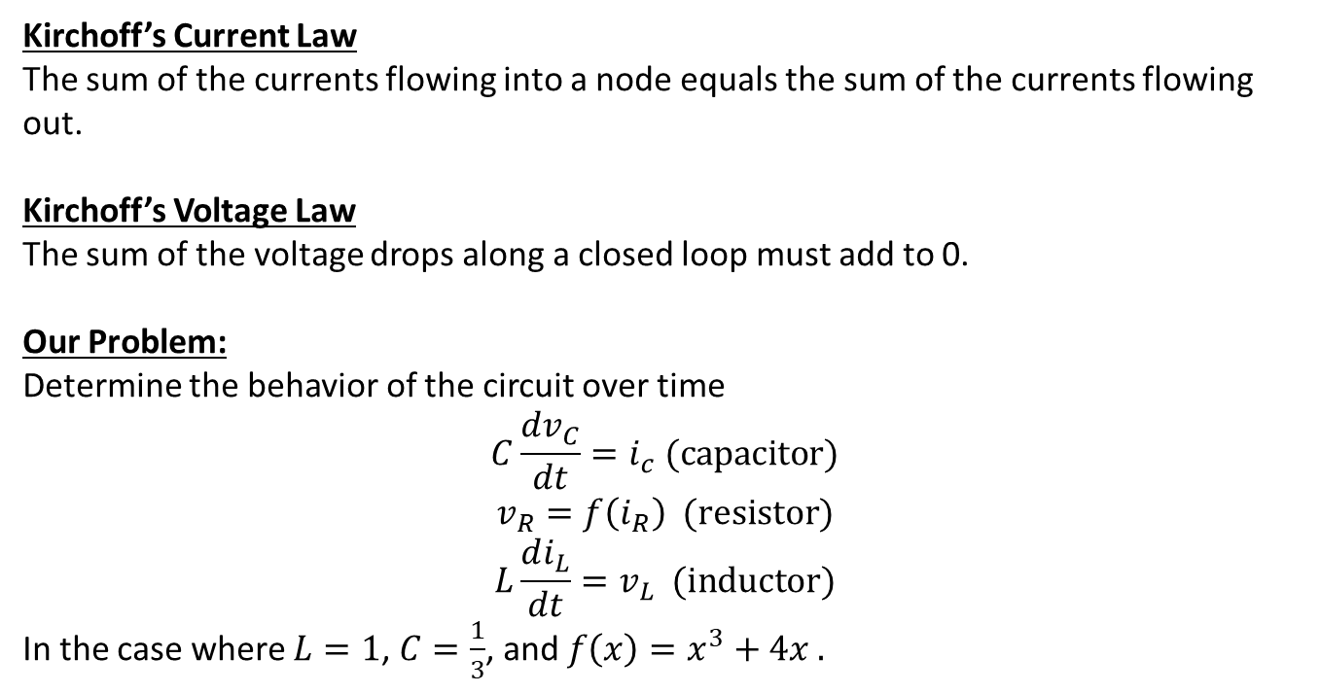
Circuits: Kirchoff’s Current Law
Kirchoff’s Current Law
The sum of the currents flowing into a node equals the sum of the currents flowing out.
Kirchoff’s Voltage Law
The sum of the voltage drops along a closed loop must add to 0.
Our Problem:
Determine the behavior of the circuit over time
$$C\frac{dv_{C}}{dt}=i_{c} (capacitor)$$
$$v_{R}=f\left(i_{R}\right) (resistor)$$
$$L\frac{di_{L}}{dt}=v_{L} (inductor)$$
In the case where $L=1$, $C=\frac{1}{3}$, and $f\left(x\right)=x^{3}+4x .$

Slide 7
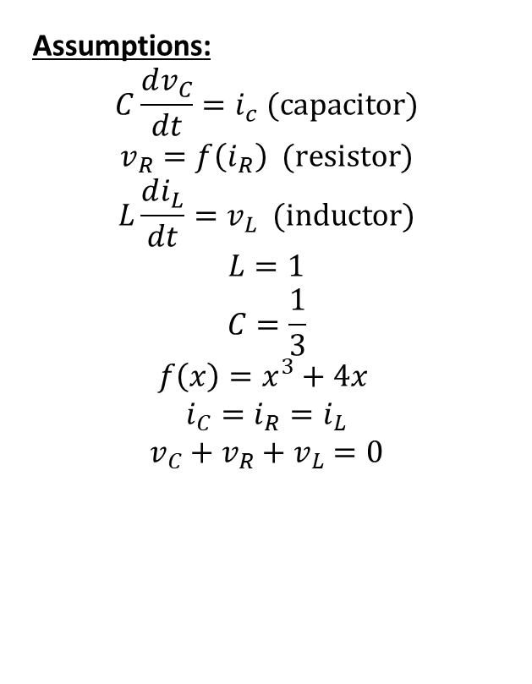
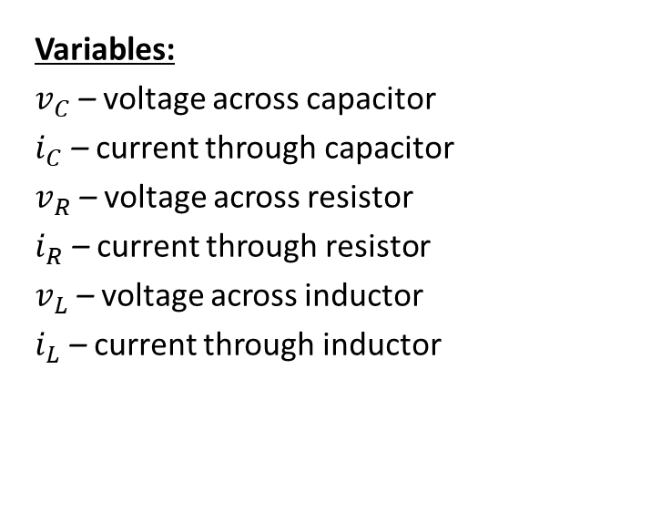
Step 1: Frame the question
Variables:
$v_{C}$ – voltage across capacitor
$i_{C}$ – current through capacitor
$v_{R}$ – voltage across resistor
$i_{R}$ – current through resistor
$v_{L}$ – voltage across inductor
$i_{L}$ – current through inductor
Assumptions:
$$C\frac{dv_{C}}{dt}=i_{c} (capacitor)$$
$$v_{R}=f\left(i_{R}\right) (resistor)$$
$$L\frac{di_{L}}{dt}=v_{L} (inductor)$$
$$L=1$$
$$C=\frac{1}{3}$$
$$f\left(x\right)=x^{3}+4x$$
$$i_{C}=i_{R}=i_{L}$$
$$v_{C}+v_{R}+v_{L}=0$$
Objective
Determine the behavior of all six variables over time.

Slide 8
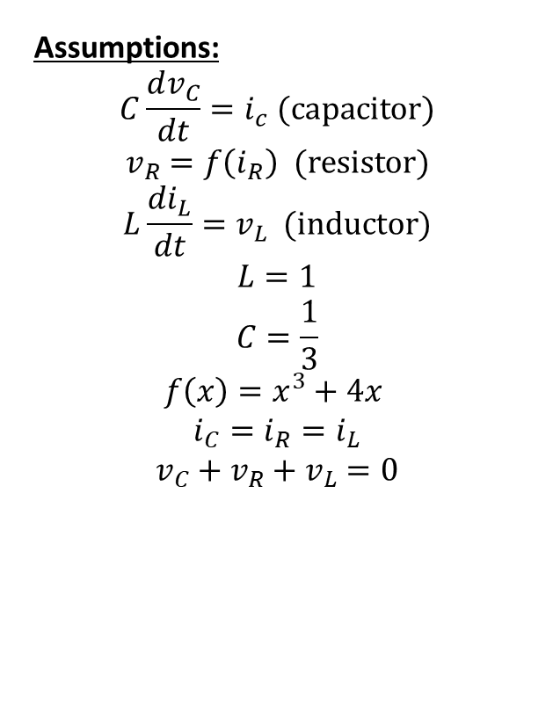
Step 2: Select the modeling approach
Variables:
$v_{C}$ – voltage across capacitor
$i_{C}$ – current through capacitor
$v_{R}$ – voltage across resistor
$i_{R}$ – current through resistor
$v_{L}$ – voltage across inductor
$i_{L}$ – current through inductor
Assumptions:
$$C\frac{dv_{C}}{dt}=i_{c} (capacitor)$$
$$v_{R}=f\left(i_{R}\right) (resistor)$$
$$L\frac{di_{L}}{dt}=v_{L} (inductor)$$
$$L=1$$
$$C=\frac{1}{3}$$
$$f\left(x\right)=x^{3}+4x$$
$$i_{C}=i_{R}=i_{L}$$
$$v_{C}+v_{R}+v_{L}=0$$
Objective
Determine the behavior of all six variables over time.
Approach
We model this as a continuous time dynamical system and analyze the system by sketching a complete phase portrait.

Slide 9
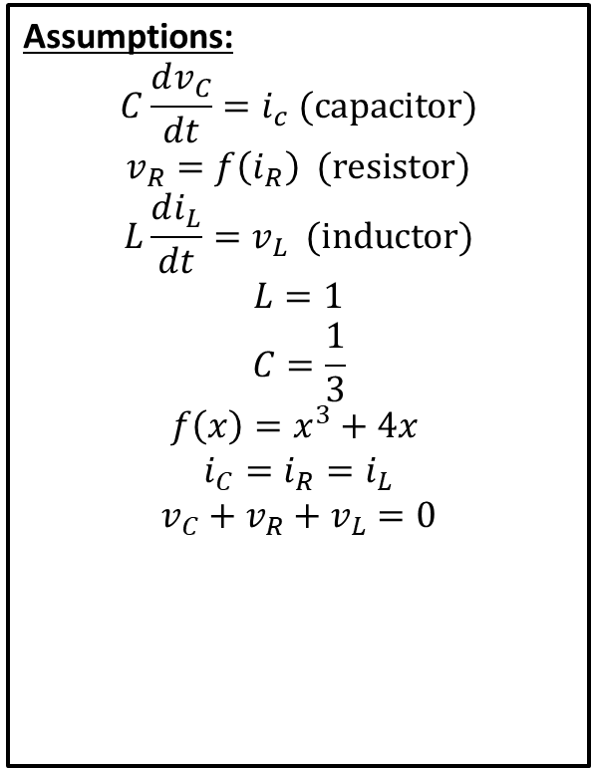
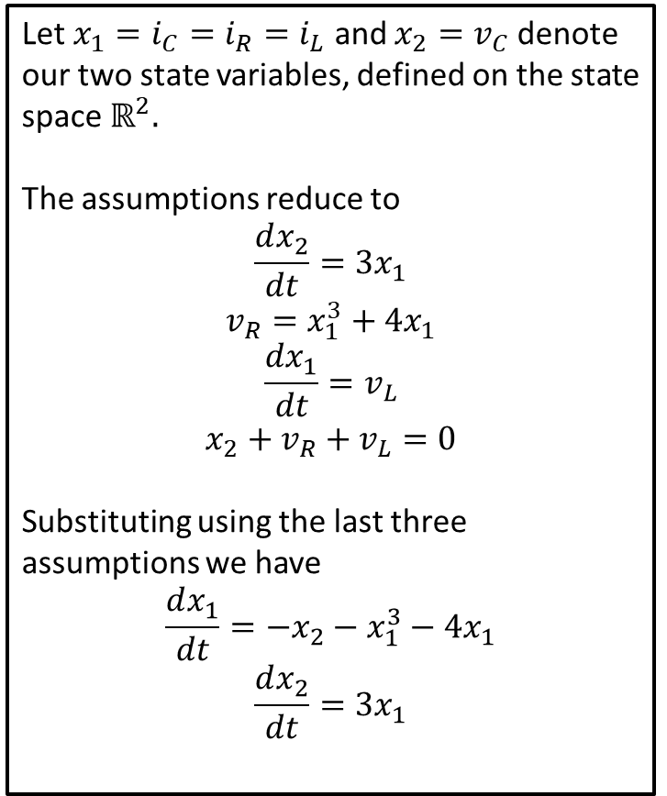
Step 3: Formulate the model
Assumptions:
$$C\frac{dv_{C}}{dt}=i_{c} (capacitor)$$
$$v_{R}=f\left(i_{R}\right) (resistor)$$
$$L\frac{di_{L}}{dt}=v_{L} (inductor)$$
$$L=1$$
$$C=\frac{1}{3}$$
$$f\left(x\right)=x^{3}+4x$$
$$i_{C}=i_{R}=i_{L}$$
$$v_{C}+v_{R}+v_{L}=0$$
Let $x_{1}=i_{C}=i_{R}=i_{L}$ and $x_{2}=v_{C}$ denote our two state variables, defined on the state space $ℝ^{2}.$
The assumptions reduce to
$$\frac{dx_{2}}{dt}=3x_{1}$$
$$v_{R}=x_{1}^{3}+4x_{1}$$
$$\frac{dx_{1}}{dt}=v_{L}$$
$$x_{2}+v_{R}+v_{L}=0$$
Substituting using the last three assumptions we have
$$\frac{dx_{1}}{dt}=−x_{2}−x_{1}^{3}−4x_{1}$$
$$\frac{dx_{2}}{dt}=3x_{1}$$

Slide 10
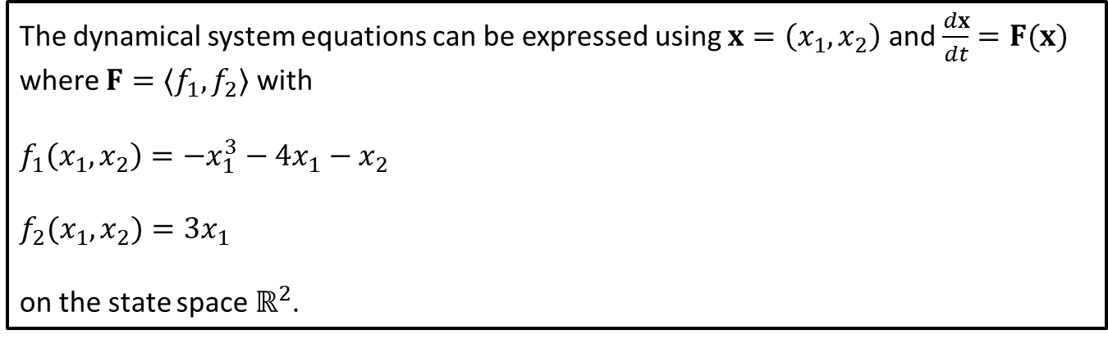

Step 3: Formulate the model
We were left with the dynamical system
$$\frac{dx_{1}}{dt}=−x_{2}−x_{1}^{3}−4x_{1}$$
$$\frac{dx_{2}}{dt}=3x_{1}$$
The dynamical system equations can be expressed using $x=\left(x_{1},x_{2}\right)$ and $\frac{dx}{dt}=F(x)$ where $F=〈f_{1},f_{2}〉$ with
$$f_{1}\left(x_{1},x_{2}\right)=−x_{1}^{3}−4x_{1}−x_{2}$$
$$f_{2}(x_{1},x_{2})=3x_{1}$$
on the state space $ℝ^{2}$.

Slide 11
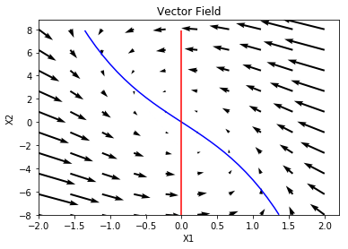

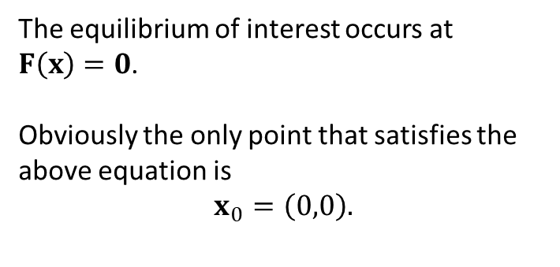
Step 4: Solve the Problem
The dynamical system equations can be expressed using $x=\left(x_{1},x_{2}\right)$ and $\frac{dx}{dt}=F(x)$ where $F=〈f_{1},f_{2}〉$ with
$$f_{1}\left(x_{1},x_{2}\right)=−x_{1}^{3}−4x_{1}−x_{2}$$
$$f_{2}(x_{1},x_{2})=3x_{1}$$
on the state space $ℝ^{2}$.
It is difficult to tell if equilibrium is stable or unstable.
The equilibrium of interest occurs at $F\left(x\right)=0$.
Obviously the only point that satisfies the above equation is
$$x_{0}=\left(0,0\right).$$
Notes:
See python file section1-1pig.py

Slide 12
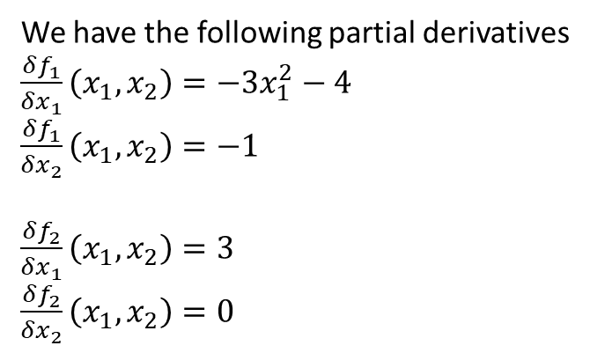
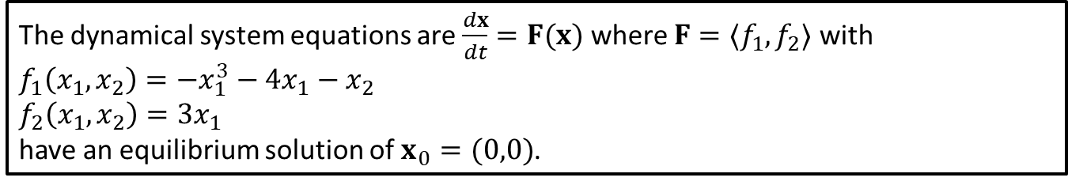
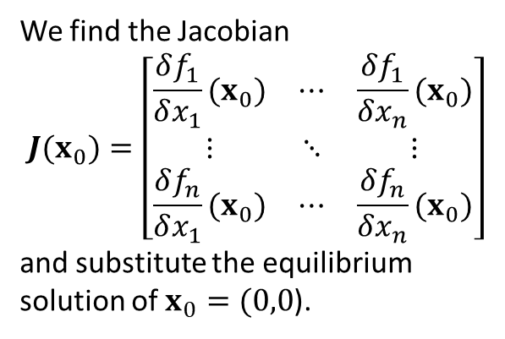
Step 4: Solve the Problem
The dynamical system equations are $\frac{dx}{dt}=F(x)$ where $F=〈f_{1},f_{2}〉$ with
$$f_{1}\left(x_{1},x_{2}\right)=−x_{1}^{3}−4x_{1}−x_{2}$$
$$f_{2}\left(x_{1},x_{2}\right)=3x_{1}$$ have an equilibrium solution of $x_{0}=(0,0)$.
We find the Jacobian
$$J(x_{0})=\left[\begin{matrix}\frac{δf_{1}}{δx_{1}}(x_{0}) & ⋯ & \frac{δf_{1}}{δx_{n}}(x_{0}) \\ ⋮ & ⋱ & ⋮ \\ \frac{δf_{n}}{δx_{1}}(x_{0}) & ⋯ & \frac{δf_{n}}{δx_{n}}(x_{0})\end{matrix}\right]$$
and substitute the equilibrium solution of $x_{0}=(0,0$).
We have the following partial derivatives
$\frac{δf_{1}}{δx_{1}}\left(x_{1}, x_{2}\right)=−3x_{1}^{2}−4$
$\frac{δf_{1}}{δx_{2}}\left(x_{1}, x_{2}\right)=−1$
$\frac{δf_{2}}{δx_{1}}\left(x_{1}, x_{2}\right)=3$
$\frac{δf_{2}}{δx_{2}}\left(x_{1}, x_{2}\right)=0$
Notes:
See python file section1-1pig.py

Slide 13
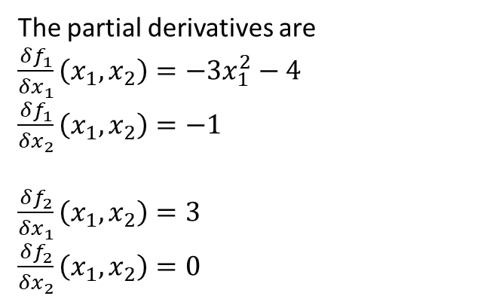

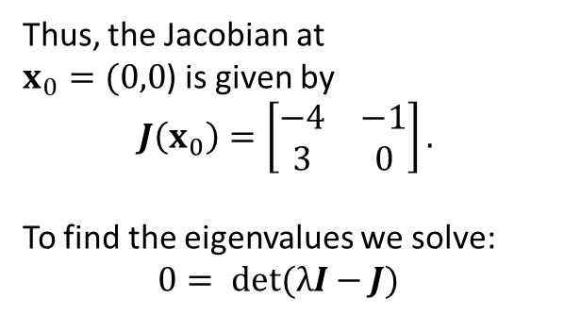
Step 4: Solve the Problem
The dynamical system equations are $\frac{dx}{dt}=F(x)$ where $F=〈f_{1},f_{2}〉$ with
$$f_{1}\left(x_{1},x_{2}\right)=−x_{1}^{3}−4x_{1}−x_{2}$$
$$f_{2}(x_{1},x_{2})=3x_{1}$$
have an equilibrium solution of $x_{0}=(0,0)$.
The partial derivatives are
$\frac{δf_{1}}{δx_{1}}\left(x_{1}, x_{2}\right)=−3x_{1}^{2}−4$
$\frac{δf_{1}}{δx_{2}}\left(x_{1}, x_{2}\right)=−1$
$\frac{δf_{2}}{δx_{1}}\left(x_{1}, x_{2}\right)=3$
$\frac{δf_{2}}{δx_{2}}\left(x_{1}, x_{2}\right)=0$
Thus, the Jacobian at $x_{0}=(0,0$) is given by
$$J\left(x_{0}\right)=\left[\begin{matrix}−4 & −1 \\ 3 & 0\end{matrix}\right].$$
To find the eigenvalues we solve:
$$0= det(λI−J)$$
Notes:
See python file section1-1pig.py

Slide 14
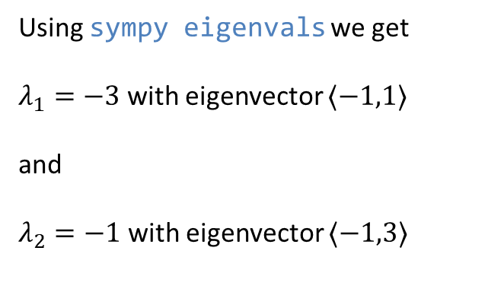
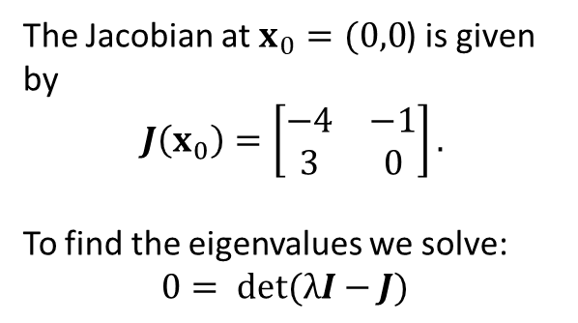
Step 4: Solve the Problem
The dynamical system equations are $\frac{dx}{dt}=F(x)$ where $F=〈f_{1},f_{2}〉$ with
$$f_{1}\left(x_{1},x_{2}\right)=−x_{1}^{3}−4x_{1}−x_{2}$$
$$f_{2}(x_{1},x_{2})=3x_{1}$$
have an equilibrium solution of $x_{0}=(0,0)$.
Using sympy eigenvals we get
$λ_{1}=−3$ with eigenvector $〈−1,1〉$
and
$λ_{2}=−1$ with eigenvector $〈−1,3〉$
The Jacobian at $x_{0}=(0,0$) is given by
$$J\left(x_{0}\right)=\left[\begin{matrix}−4 & −1 \\ 3 & 0\end{matrix}\right].$$
To find the eigenvalues we solve:
$$0= det(λI−J)$$
Notes:
See python file section1-1pig.py

Slide 15
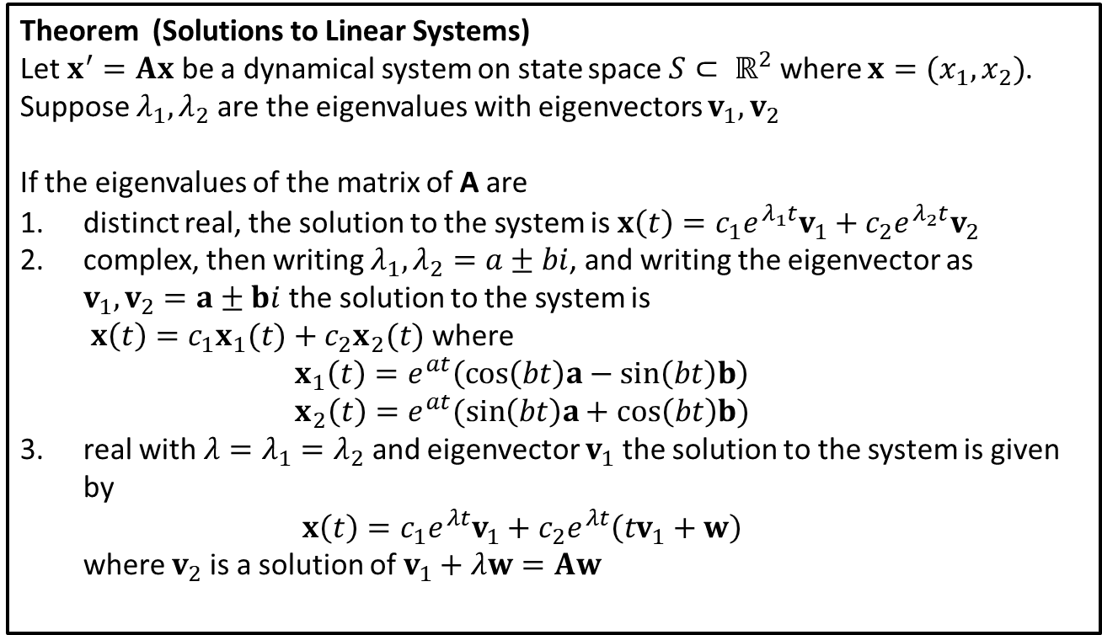
Theory: Linear Systems
Theorem (Solutions to Linear Systems)
Let $x^{′}=Ax$ be a dynamical system on state space $S⊂ ℝ^{2}$ where $x=(x_{1},x_{2})$. Suppose $λ_{1}, λ_{2}$ are the eigenvalues with eigenvectors $v_{1}, v_{2}$
If the eigenvalues of the matrix of A are
distinct real, the solution to the system is $x\left(t\right)=c_{1}e^{λ_{1}t}v_{1}+c_{2}e^{λ_{2}t}v_{2}$
complex, then writing $λ_{1}, λ_{2}=a±bi$, and writing the eigenvector as $v_{1},v_{2}=a±bi$the solution to the system is $x\left(t\right)=c_{1}x_{1}(t)+c_{2}x_{2}(t)$ where $x_{1}\left(t\right)=e^{at}\left(cos\left(bt\right)a−sin\left(bt\right)b\right)$ $x_{2}\left(t\right)=e^{at}(sin\left(bt\right)a+cos\left(bt\right)b)$
real with ${λ=λ}_{1}=λ_{2}$ and eigenvector $v_{1}$ the solution to the system is given by $x\left(t\right)=c_{1}e^{λt}v_{1}+c_{2}e^{λt}\left(tv_{1}+w\right)$ where $v_{2}$ is a solution of $v_{1}+λw=Aw$
Notes:
Note the eigenvector the conjugate eigenvalues is the conjugate eigenvector.
See python file section1-1pig.py

Slide 16
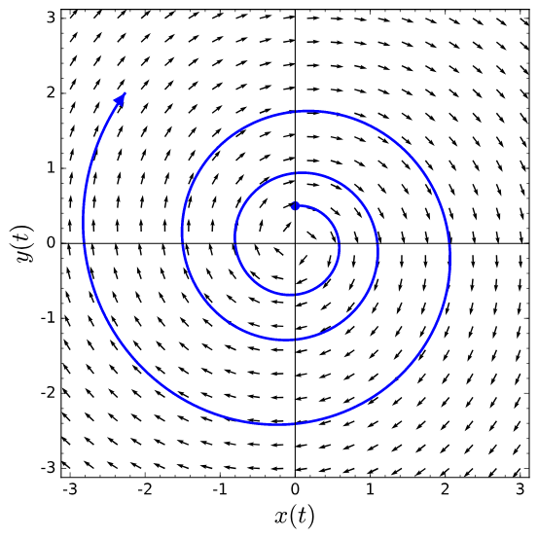
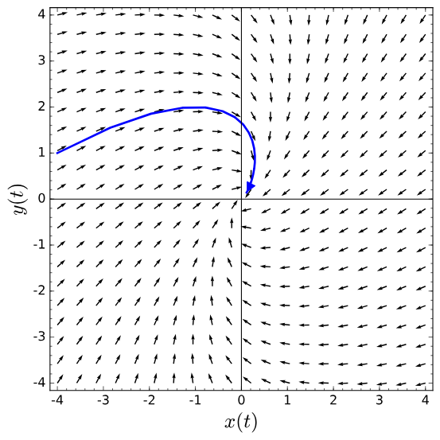
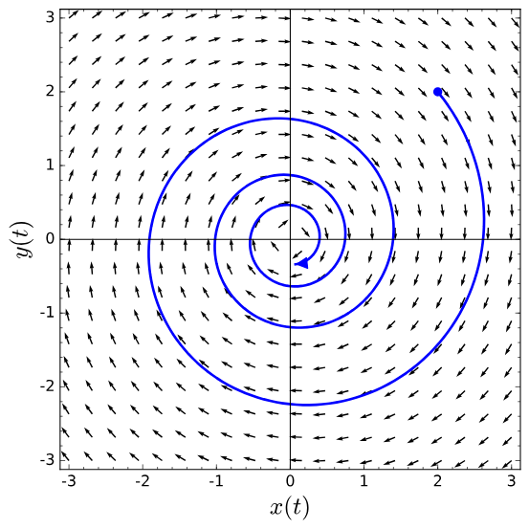
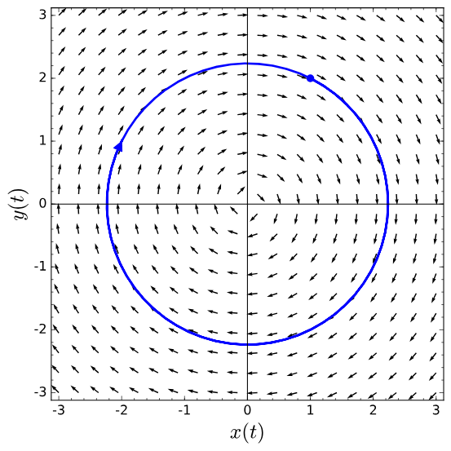
unstable – an eigenvalue has a positive real part
Stable – eigenvalues have negative real parts
All eigenvalues have 0 real part (pure imaginary)
Notes:
Review

Slide 17
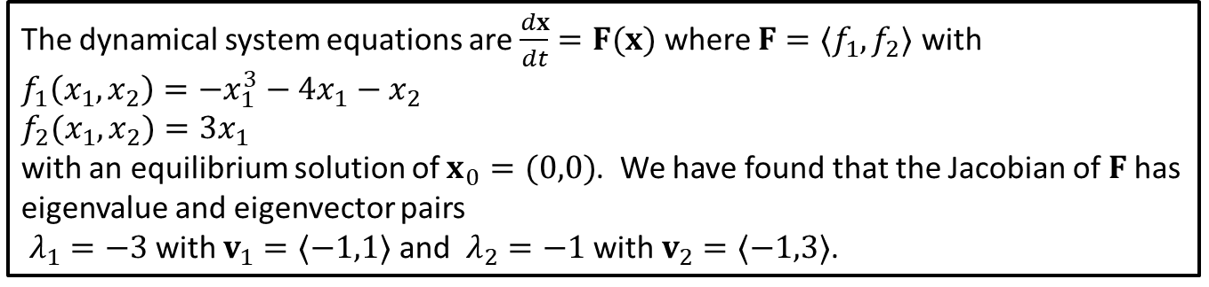
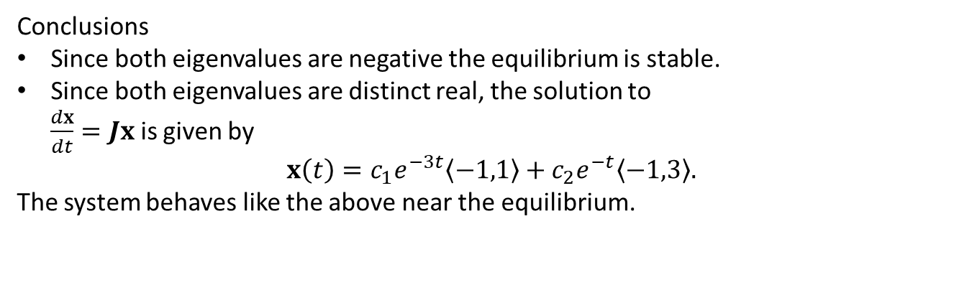
Step 4: Solve the Problem
The dynamical system equations are $\frac{dx}{dt}=F(x)$ where $F=〈f_{1},f_{2}〉$ with
$$f_{1}\left(x_{1},x_{2}\right)=−x_{1}^{3}−4x_{1}−x_{2}$$
$$f_{2}(x_{1},x_{2})=3x_{1}$$
with an equilibrium solution of $x_{0}=(0,0)$. We have found that the Jacobian of $F$has eigenvalue and eigenvector pairs
$λ_{1}=−3$ with $v_{1}=〈−1,1〉$ and$λ_{2}=−1$ with $v_{2}=〈−1,3〉$.
Conclusions
Since both eigenvalues are negative the equilibrium is stable.
Since both eigenvalues are distinct real, the solution to $\frac{dx}{dt}=Jx$ is given by
$$x\left(t\right)=c_{1}e^{−3t}〈−1,1〉+c_{2}e^{−t}〈−1,3〉.$$ The system behaves like the above near the equilibrium.
Notes:
See python file section1-1pig.py

Slide 18
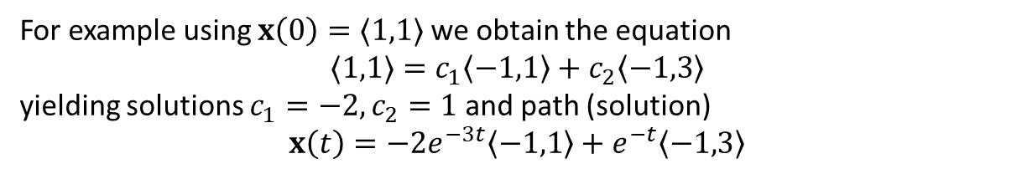
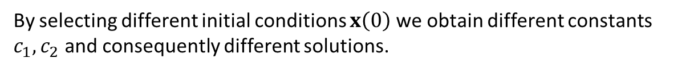
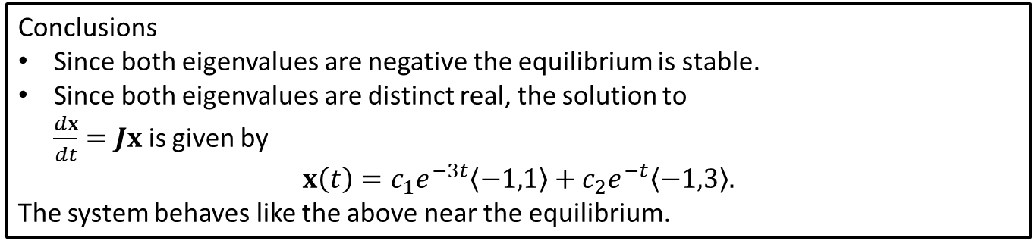
Step 4: Solve the Problem
Conclusions
Since both eigenvalues are negative the equilibrium is stable.
Since both eigenvalues are distinct real, the solution to $\frac{dx}{dt}=Jx$ is given by
$$x\left(t\right)=c_{1}e^{−3t}〈−1,1〉+c_{2}e^{−t}〈−1,3〉.$$ The system behaves like the above near the equilibrium.
By selecting different initial conditions $x\left(0\right)$ we obtain different constants $c_{1},c_{2}$ and consequently different solutions.
For example using $x\left(0\right)=〈1,1〉$ we obtain the equation
$$〈1,1〉=c_{1}〈−1,1〉+c_{2}〈−1,3〉$$
yielding solutions $c_{1}=−2, c_{2}=1$ and path (solution)
$$x\left(t\right)=−2e^{−3t}〈−1,1〉+e^{−t}〈−1,3〉$$
Notes:
See python file section1-1pig.py

Slide 19
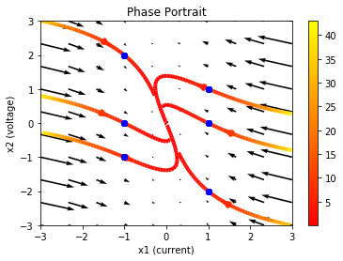
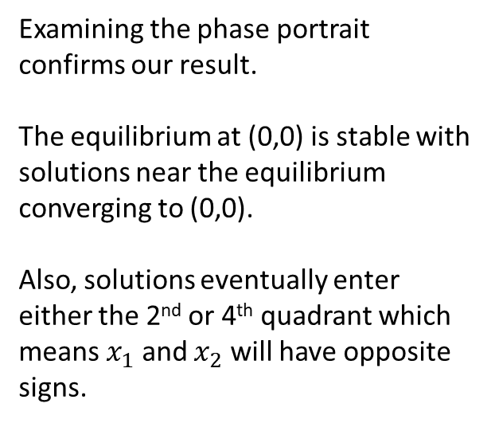
Step 4: Solve the Problem (Phase Portrait)
Conclusions
Since both eigenvalues are negative the equilibrium is stable.
Since both eigenvalues are distinct real, the solution to $\frac{dx}{dt}=Jx$ is given by
$$x\left(t\right)=c_{1}e^{−3t}〈−1,1〉+c_{2}e^{−t}〈−1,3〉.$$ The system behaves like the above near the equilibrium.
Examining the phase portrait confirms our result.
The equilibrium at (0,0) is stable with solutions near the equilibrium converging to (0,0).
Also, solutions eventually enter either the 2nd or 4th quadrant which means $x_{1}$ and $x_{2}$ will have opposite signs.
Notes:
See python file section1-1pig.py

Slide 20
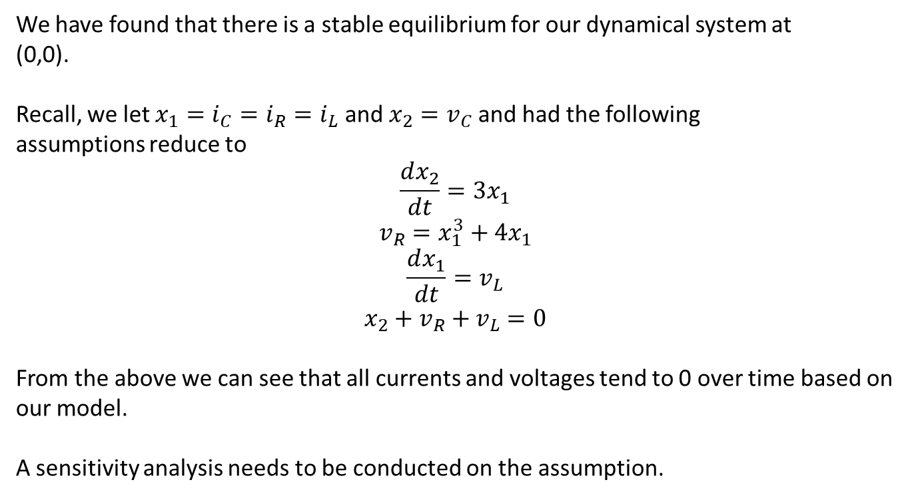
Step 5: Answer the question
We have found that there is a stable equilibrium for our dynamical system at
(0,0).
Recall, we let $x_{1}=i_{C}=i_{R}=i_{L}$ and $x_{2}=v_{C}$ and had the following
assumptions reduce to
$$\frac{dx_{2}}{dt}=3x_{1}$$
$$v_{R}=x_{1}^{3}+4x_{1}$$
$$\frac{dx_{1}}{dt}=v_{L}$$
$$x_{2}+v_{R}+v_{L}=0$$
From the above we can see that all currents and voltages tend to 0 over time based on our model.
A sensitivity analysis needs to be conducted on the assumption.

